Slide 1
Welcome to Sociology

Slide 2


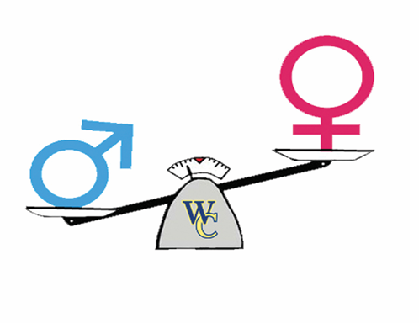
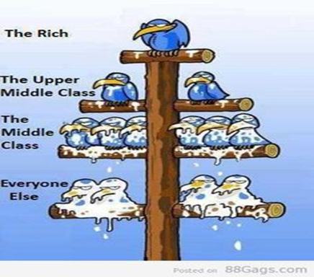

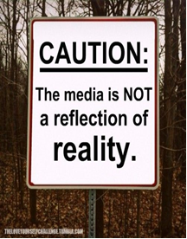
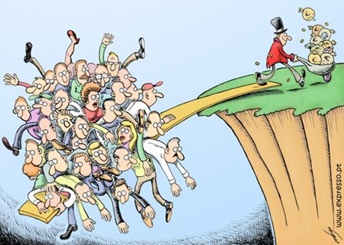
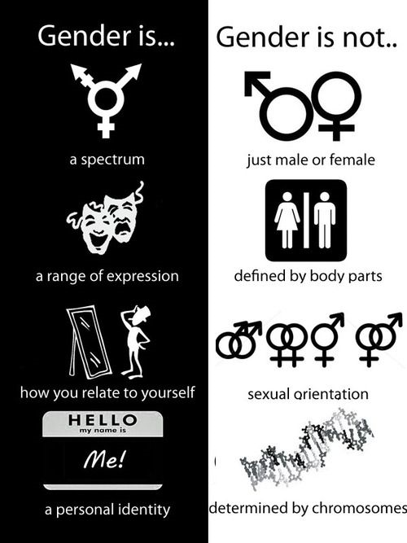

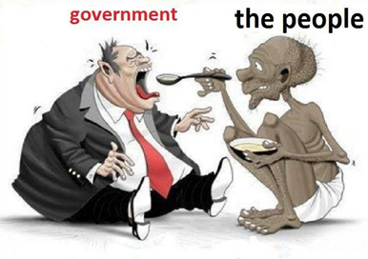


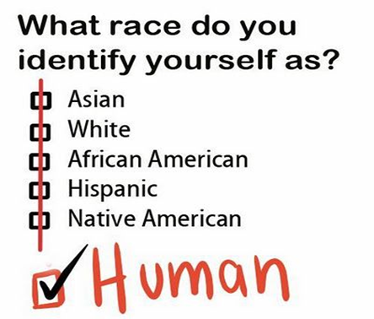
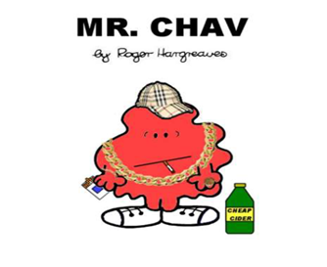
Sociology
We follow the AQA A-level specification
If you have any questions over the summer email
swormaldj@deanery.wigan.sch.uk

Slide 3

Sociology is…
The study of society, large groups of people and individuals.
It studies how and why people behave the way they do in society
Is sociology for me?
Yes, if you’re interested in questions like these…
Are children and young people treated unfairly in society?
Why are some people rich and some people poor?
Are people successful because of their background or how hard they work?
Why are some of the hardest jobs poorly paid?
Why are a large proportion of MPs white, male and from private schools?
Would the world be happier if there was just one religion?

Slide 4
Sociology- What is it?
https://www.youtube.com/watch?v=LK5J0-cM-HE
What are the things that influence your life?
What kind of society do you live in?

Slide 5
Am I influenced by my environment?
Derren Brown
https://www.youtube.com/watch?v=ywvDlhNg5xM
Mass Media
https://www.youtube.com/watch?v=YQXe1CokWqQ

Slide 6
Task- Watch some TV
Sociology is everywhere, so you’ll be able to see aspects of it in all forms of media.
Black Mirror- White Bear (Netflix) – Think about the criminal justice system in society.
Black Mirror- Nosedive- Think about the use of social media in our society
I, Daniel Blake- Film- Think about the welfare system.
Blood Diamond- Film- Think about our country, a democracy.

Slide 7
How the Course is Assessed:
There is no coursework in Sociology.
Students sit exams at the end of Year 12 and Year 13. AQA Sociology A-level is a linear course. AS or Year 12 helps you develop the key critical skills, thinking and social comprehension. Whereas as Year 13 allows you to practice these skills and complete your Sociological Imagination.
Year 12
Paper One: | Paper Two:
Education Methods in Context - 50% of AS Level | Research Method Families and Households - 50% of A Level
Year 13
Paper One: | Paper Two: | Paper Three:
Education Methods in Context Theory and Methods - 33% of A Level | Families Mass Media - 33% of A Level | Crime and Deviance Theory and Methods - 33% of A Level

