Slide 1
BTEC
APPLIED LAW
AT
The Deanery High School and Sixth Form

Slide 2
What is law?
Some things are considered morally wrong by society, but are not illegal. For example, adultery is often considered to be morally wrong by society, but it is not illegal.
Legal rules are set by Parliament.
Moral rules are set by society.
The study of law is about what is legally ‘wrong’.

Slide 3
What is law?
Law governs what we can and cannot do, it is used to settle disputes, to punish and to govern.
When people think about law they often think about crimes e.g. murder, assault, drink driving etc.
Criminal law is just one area of law and you will need to learn about other areas to truly understand what law is.

Slide 4
Other areas of law include….
Negligence
Criminal
Human Rights
Family
Commercial
Immigration Law
Land Law
Wills and Probate
Contract Law
Conveyancing
Company Law
Public Law
EU Law
Consumer Law
…but don’t panic, not all these areas are studied on this course!

Slide 5
BTEC Applied Law – What will I study?
Year One
  Unit 1 - Dispute Solving in Civil Law
  Unit 2 - Investigating Aspects of Criminal Law and the Legal System

Slide 6
BTEC Applied Law – What will I study?
Unit 1 - Dispute Solving in Civil Law
  What is civil law?
  English Civil Courts
  Alternatives to court action
  Legal skills
  Sources of advice
  Sources of funding
  Damages
  Burden of proof

Slide 7
BTEC Applied Law – What will I study?
Unit 2 – Investigating elements of criminal law and the legal system
  Criminal legal personnel
  Elements of a crime
  Non-fatal offences against the person
  Sentencing
  Influences on Parliament
  The law making process
  Statutory interpretation
  Delegated legislation
  The European Union

Slide 8
BTEC Applied Law – What will I study?
Year Two
  Unit 3 Applying the Law
  Unit 4 Family Law

Slide 9
BTEC Applied Law – What will I study?
Unit 3 – Applying the law
  Murder
  Manslaughter
  Burglary
  Robbery
  Theft
  Fraud
  Police Powers

Slide 10
BTEC Applied Law – What will I study?
Unit 4 – Family Law
  Marriage, civil partnerships and cohabitation
  How to dissolve a relationship
  Distributing money and property following a breakdown.
  Disputes over children

Slide 11
Questions?
If you have any questions or queries please feel free to contact the Sixth Form team or the law teacher, Mrs McLoughlin-Settle direct at smcloughlinsettlej@deanery.wigan.sch.uk

Slide 12
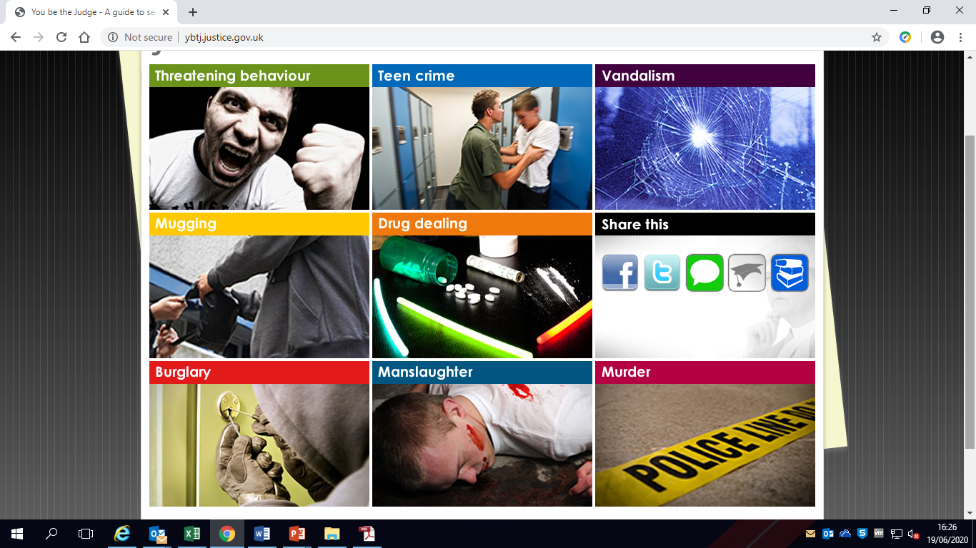
You be the Judge!
Try this interactive sentencing activity
Click below to start

