Slide 1
Welcome to your new course
Pearson BTEC Level 3 National Diploma (2 A level equivalent)/Extended Certificate (1 A level equivalent) in Health and Social Care

Slide 2
What is this course?
Btec level 3 DIPLOMA in Health & Social Care
It is equivalent to 2 A levels
It entails 8 units
3 of these are exam units and 5 are coursework
It provides learners with a good introduction and insight into the health & social care sector
It supports access to a range of higher education courses I
for the health and social care sector

Slide 3
What is this course?
Btec level 3 Extended Certificate in Health & Social Care
It is equivalent to 1 A level
It entails 2 units
2 of these are exam units and 2 are coursework
It provides learners with a good introduction and insight into the health & social care sector
It supports access to a range of higher education courses I
for the health and social care sector

Slide 4

Success in Health & Social Care
We are a very successful department with all students passing the course since we started
This is achieved though hard work and total commitment from students and staff
It is a key to your future
This Photo by Unknown Author is licensed under CC BY

Slide 5

EXAMPLES OF Student success in
HEALTH & SOCIAL CARE
Midwifery degree at John Moore University
Salford University studying Biomedical Science
Apprenticeship in Health & Fitness
University studying Criminology & Psychology
University studying Science
University studying adult or children’s nursing, social work or psychology

Slide 6
What does a btec look like?
Specification
requirements:
Content-coursework/exams
Units to be
covered
Learning
Outcomes
Unit/course
Achievement
Grading Criteria
Pass
Merit
Distinction

Slide 7
Achieving your Btec
Your course may be a mixture of internally assessed coursework, externally assessed examinations or placement requirements
To gain achievement you must :-
Pass = All Pass criteria achieved
Merit = All Pass and all Merit criteria achieved
Distinction = All Pass, all Merit and all Distinction criteria achieved
If you do not complete work, units or pass exams your grade will be unclassified

Slide 8
Assessment through operative verbs
Each piece of your work will need to apply to an operative verb. These are command verbs that you must address in your work.
The following slides give you an idea of common operative verbs used in Btec
As you progress through Pass to Merit to Distinction the verbs progress by requiring higher order thinking
For example at Pass level you may be asked to merely describe something, at Merit you may be required to justify something, while to achieve Distinction you may need to analyse or evaluate something

Slide 9
EXAMPLES OF Pass verbs
Describe- Give a clear description that includes all the relevant features - think of it as ‘painting a picture with words’
Define - Clearly explain what a particular term means and give an example, if appropriate, to show what you mean
Explain -Set out in detail the meaning of something, with reasons. More difficult than describe or list, so it can help to give an example to show what you mean. Start by introducing the topic then give the ‘how’ or ‘why’
Identify - Point out or choose the right one or give a list of the main features
Illustrate - Include examples or a diagram to show what you mean
Interpret -Define or explain the meaning of something
List - Provide the information in a list, rather than in continuous writing
Summarise -Write down or articulate briefly the main points or essential features

Slide 10
EXAMPLES OF Merit verbs
Assess -Give careful consideration to all the factors or events that apply and identify which are the most important or relevant
Compare/Contrast - Identify the main factors that apply in two or more situations and explain the similarities and differences or advantages and disadvantages
Demonstrate - Provide several relevant examples or related evidence which clearly support the arguments you are making. This may include showing practical skills
Explain in detail - Provide details and give reasons and/or evidence to clearly support the argument you are making
Justify How/Why - Give reasons or evidence to support your opinion or view to show how you arrived at these conclusions

Slide 11
EXAMPLES OF Distinction verbs
Analyse - Identify separate factors, say how they are related and how each one contributes to the topic
Criticise - Review a topic or issue objectively and weigh up both positive and negative points before making a decision
Draw conclusions - Use the evidence you have provided to reach a reasoned judgement
Evaluate - Review the information then bring it together to form a conclusion. Give
evidence for each of your views or statements
Evaluate critically- Decide the degree to which a statement is true or the importance or value of something by reviewing the information. Include precise and detailed information and assess possible alternatives, bearing in mind their strengths and weaknesses if they were applied instead

Slide 12
Internal Verification of your Work
After your work has been marked by your teacher, to ensure marking is accurate and consistent and to safeguard your result, your assessed work may be internally verified (checked) by another member of staff
This is the reason you must include an Assessment Decision Form along with a front Assessment Feedback From with your completed coursework
Once safely achieved your completed coursework must not go home and will be safely stored by your subject teachers until your course is finished
Notes:
GIVE OUT ADF

Slide 13
Plagiarism
Plagiarism is the dishonest presentation of the work of others as if it were your own
Copying directly from any source and not referencing appropriately will be considered plagiarism
Work submitted by you must be in their own words with exception only for references in the text which must be acknowledged both in references and bibliography
Any student found to plagiarise their work will be referred and you will be asked to restart the relevant piece of work

Slide 14
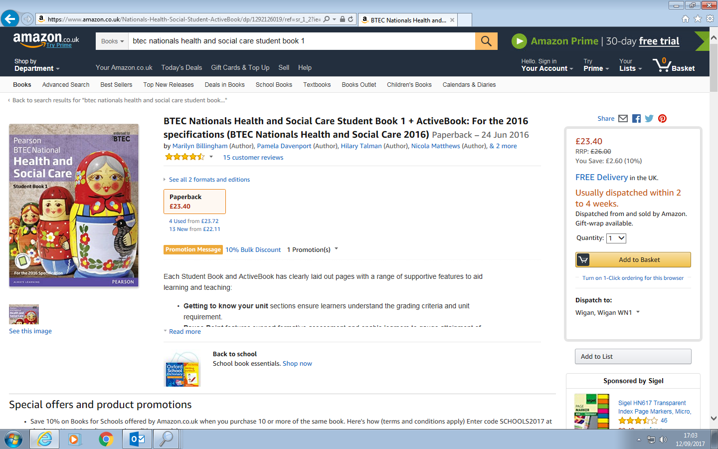

Slide 15
Top tips
Start work on your coursework straight away
Revise for your exam every week even though it seems a long way off, there is a lot of content you need to cover
Ask if you need help
Good luck and enjoy!

