Slide 1
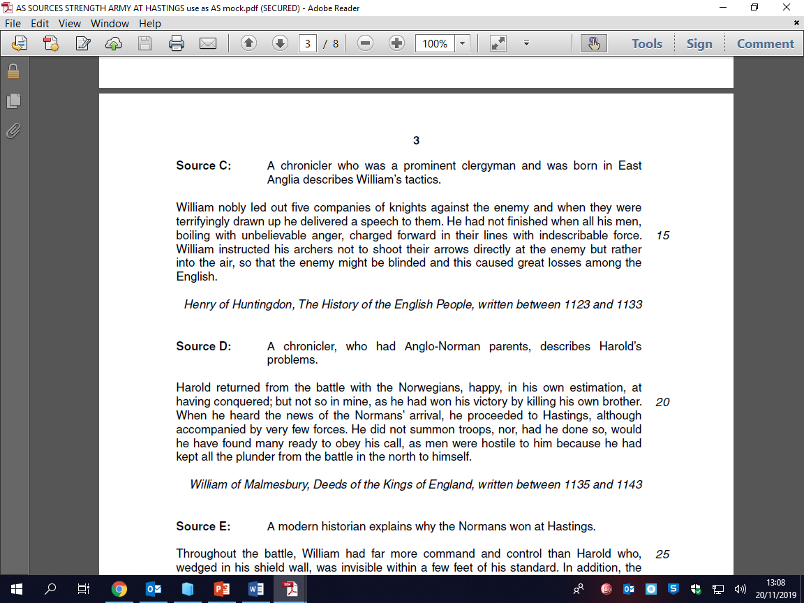
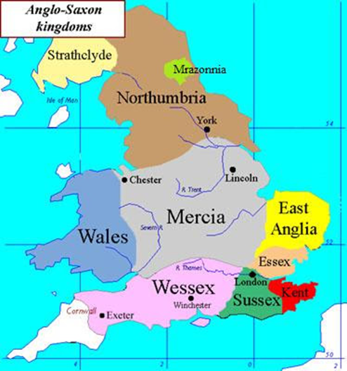
Bridging the Gap – A Level History
Anglo-Saxon England and the Norman Conquest
Define these key words:
Research the four claimants to the throne in 1066 – if you were a part of the Witan, who would you choose to be king? Explain your answer.
Key word | Definition
Ceorl
Danegeld
Fyrd
Feigned retreat
Housecarls
Murdrum
Thegn
Shire
Witan
Harold Godwinson
Edgar Aetheling
Harold Hardrada
William,
Duke of Normandy
How far does this source support the view that William I’s leadership was the main reason for the Norman victory at Hastings?
Create a map of the Anglo-Saxon earldoms.
Use records from the Domesday Book to find out the name of any shires recorded under the Normans
Research the death of William II ’Rufus’ – what is suspicious about it? What did this mean for England?

